Slide 1
IE Organizational Building Leadership Program
Session #3: Fostering Organizational and Individual Resiliency
8/29/2024
Dhaujée Rose
Strategist, Healing Artist, and Facilitator

Slide 2



Cultivating Communities of Care
How centering values of care and mindfulness can cultivate more resilient organizations.
Dhaujée Rose
Strategist and Facilitator
Dhaujée Mind+Body
hello@dhaujee.com
Notes:
Facilitator Intro

Slide 3
Agenda
Welcome and Introductions
Self - Care is Community Care
Break
Successful Models of Care
Moving into Practice
Upcoming Sessions
Final Reflections

Slide 4
Cultivating Communities of Care
Introductions
Name
Organization
One thing you did or will do to care for yourself, today.
Notes:
Part 1

Slide 5
Cultivating Communities of Care
Self-Care is Community Care
Grounding Question: What does your self-care practice look like in action?
“When we don't take our own rest while holding space for others around us to rest, we are functioning like the systems we want to gain freedom from.”
Tricia Hersey
Rest Is Resistance: A Manifesto.
Notes:
Facilitator Intro

Slide 6
Cultivating Communities of Care
Interactives: Self - Care Assessment
Personal Reflection: Did any questions or emotions come up for you while doing your self-care checklist? What were they and what experiences may have triggered these responses?
Notes:
Part 1

Slide 7
Breakout Groups
Group Instructions:
Collaborate to come up with 5 -7 items for a ‘Work Self- Care’ Checklist. Choose one person from the group to scribe responses directly onto the document
Guiding Questions:
What does care look like in the work space? How can having a checklist like this for work support cultivating better organizational habits? What elements of your organization’s structures and processes are mindful of staff needs?

Slide 8
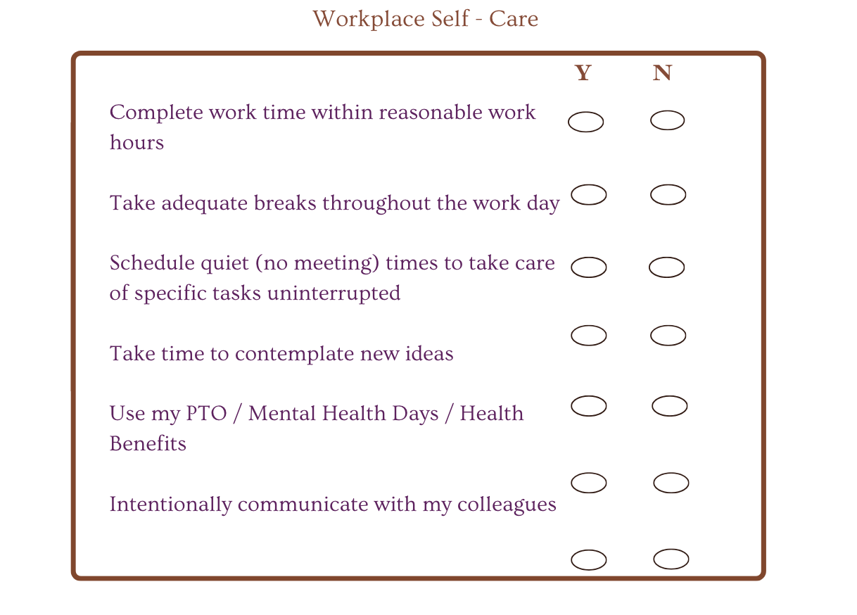
Sample Workplace Self-Care Checklist

Slide 9
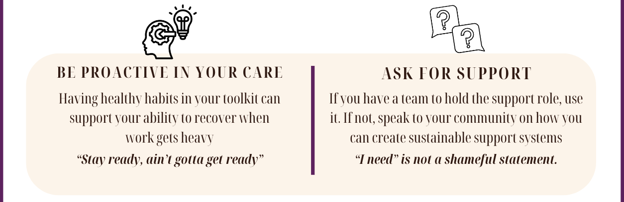
Self-Care Toolkit
Overcoming Burnout and Compassion Fatigue

Slide 10
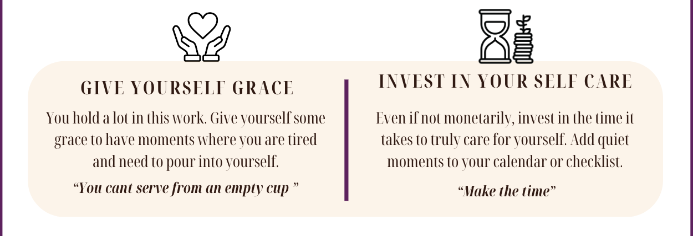
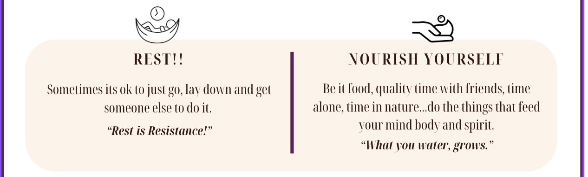
Self-Care Toolkit
Overcoming Burnout and Compassion Fatigue

Slide 11
Cultivating Communities of Care
Successful Care Models
Grounding Question: What are the properties of successful care models and how do we embody them as a system, community, and individual?
“Create space for learning something that we thought we already knew”
Rhonda McGee
The Inner Work of Racial Justice
Notes:
Facilitator Intro

Slide 12
MINDFUL MODELS
What makes a successful care / service model?
Organizational Culture of Quality Care / Service Model
Leadership Across Levels
Customization to Context
Strong Team Relationships, Including Participants and Partners
Training Appropriate to Circumstances
Continuous Assessment with Effective Metrics
Use of Multiple Sources of Data

Slide 13
MINDFUL MODELS
What makes a successful care / service model?
Mindful Attributes
Assessment
Targeting
Planning
Alignment
Communication
Monitoring
Continuity

Slide 14
MINDFUL MODELS
What makes a successful care / service model?
Delivery Features
Teamwork
Coordination
Responsiveness
Feedback
Service management
Outreach
Integration
Follow-up

Slide 15
Break Out Groups - Group Reflections (20 - 25 minutes)
Within your group, read the excerpt. Take time to discuss how your personal values of care reflect how you show up as a leader. How do these values contribute to your organization’s models of service and care? Which of these elements feel most accessible? Which offers challenges within your organization?

Slide 16
Group Reflection Responses

Slide 17
Cultivating Communities of Care
The Practice of Resilience
Grounding Question: How can personal and professional mindfulness encourage organizational impact and resilience?
“Cultivate a safe space for leaders to be vulnerable, being in mutual support with a goal of countering leader isolation”
Adrienne Marie Brown
Emergent Strategy.
Notes:
Facilitator Intro

Slide 18
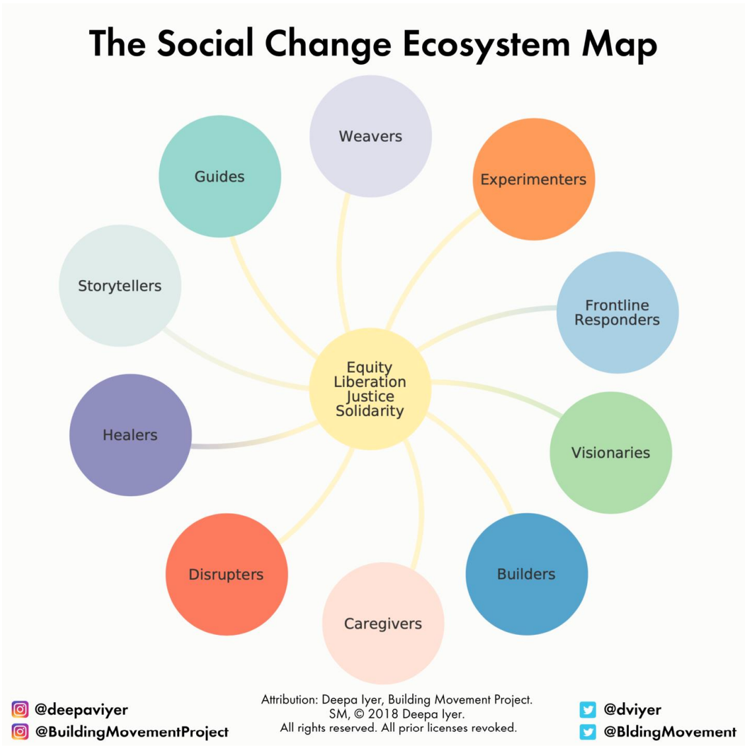
Social Change Ecosystem
These are the archetypes that move the work forward. Which are you embodying? How do habits cultivate archetypes?

Slide 19
The Practice of Resilience
If you could choose one social change archetype for your organization and one for yourself, what would they be?
Why is that important to your organization’s resilience?

Slide 20
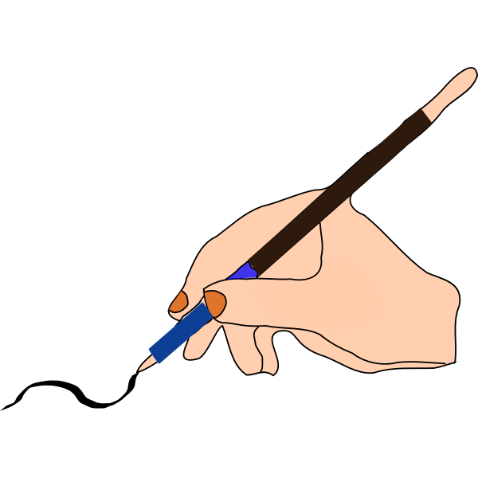
Closing Reflection
Is it possible or sustainable for you to be everything, everywhere, all at once? In what ways can we lean on our systems and community for support?

Slide 21
Thank you for your time and support!

